Slide 1
Audience Response Clickers
You need:
A physical device
A license
Register in Blackboard

Slide 2
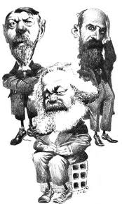
Week 2
The Sociological Perspective: Theory

Slide 3
Brief Overview
Sociological Perspective
Sociological Imagination
Biography and History
Personal and Public
Personal Tastes
History
Biography

Slide 4
Micro → → → → Meso → → → → Macro
Economy
Polity
Culture
Health Care
Military
Religion
Marriage
and Family
Law and Criminal
Justice System
Schools and
Education
Media
Education Status
Gender
Race
Ethnicity
Class
Sexual
Orientation
Age/ Age
Cohort
Marital Status
Citizenship
Ability
Interpersonal interactions
Language Symbols Conversations

Slide 5
Structure
vs.
Agency
?
?

Slide 6
Berger’s Invitation to Sociology
The sociologist…is a person intensively, endlessly, shamelessly interested in the doings of men. His natural habitat is all the human gathering places of the world, wherever men come together. The sociologist may be interested in many other things. But his consuming interest remains in the world of men, their institutions, their history, their passions.

Slide 7
Brief Overview
Sociological Perspective
Sociological Imagination
Research Methods = How?
Apply Scientific Methods to Society
Theoretical Perspectives = Why?
Explaining Social Phenomena

Slide 8
Theory: Why do social phenomena occur?
Functionalist
Conflict
Symbolic Interactionist

Slide 9
Theory: Why do social phenomena occur?
Functionalism
Emile Durkheim, Talcott Parsons
Manifest vs. Latent Functions
Dysfunctions

Slide 10
Theory: Why do social phenomena occur?
Conflict Theory
Karl Marx
Classes
Materialism
Alienation

Slide 11
Theory: Why do social phenomena occur?
Symbolic Interactionism
George Herbert Mead
Symbols
Self and Generalized Other

Slide 12
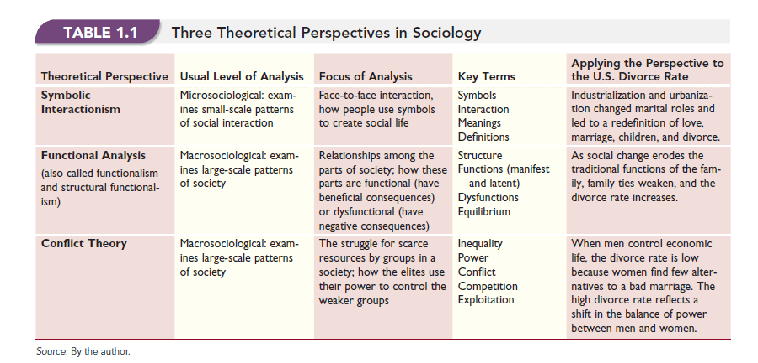
From Henslin Text, Chapter 1

Slide 13
Median weekly earnings of full-time wage and salary workers ages 16+ in the US 2013
Source: US Bureau of Labor Statistics
Notes:
Women are earning about 82% of what men earn

Slide 14
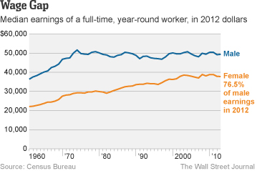

Slide 15
Median weekly earnings of full-time wage and salary workers ages 16+ in the US 2013
Theory
Application
Source: US Bureau of Labor Statistics

Slide 16
Next…
C Wright Mills and “The Promise”

